Slide 1
Logistic regression

Slide 2
Introduction
In many situations, the response variable is qualitative(categorical)
Email Spam or not, person will buy an insurance, which party person will vote.
Approach for predicting qualitative responses is known as classification.

Slide 3
Types of Logistic Regression
Binary Logistic Regression
The categorical response has only two 2 possible outcomes. Example: Spam or Not
2. Multinomial Logistic Regression
Three or more categories without ordering. Example: Predicting which food is preferred more (Veg, Non-Veg, Vegan)
3. Ordinal Logistic Regression
Three or more categories with ordering. Example: Movie rating from 1 to 5

Slide 4
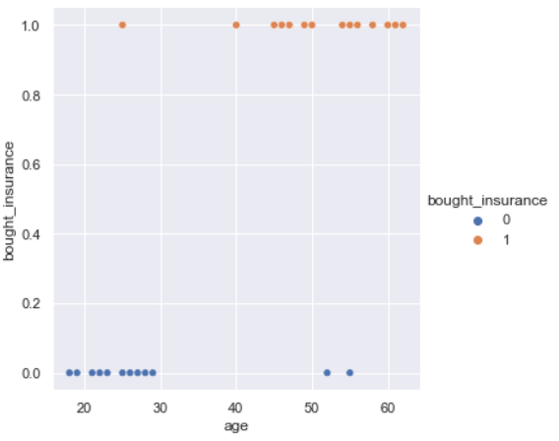
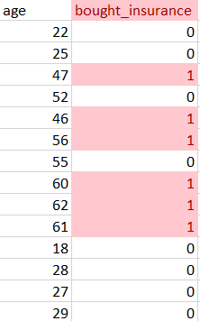

Slide 7
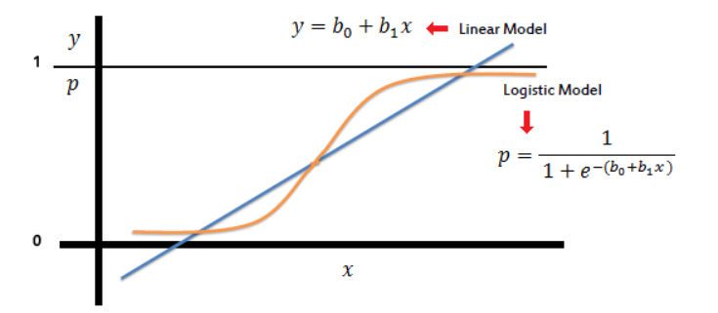
Logistic Regression Model
In logistic regression, the outcome
It must always be positive (since p >= 0)
It must always be less than equals to 1 (since p <= 1)
In the logistic regression the constant (b₀) moves the curve left and right (cutoff point where x-values change from high to low probability and vice versa) and the slope (b₁) defines the steepness of the curve.
Sigmoid Function

Slide 8
How is logistic regression different from linear regressions?
If we estimate probability using a simple linear regression model, a straight line, p = β0 + β1x. However, it doesn’t make sense, due to the following reasons:
The y variable is categorical (yes or no), not quantitative.
Categorical data don’t have a normal distribution
The estimated values of p can never be outside of [0, 1], which goes against the idea of a straight line (a straight line continues on in both directions).
It doesn’t make sense to force the values of p to increase in a linear way based on x.
Notes:
For example, an event may occur very frequently with a range of large values of x and very frequently with a range of small values of x, with very little chance of the event happening in an area in between.

Slide 9


Logistic Regression Model
By simple transformation, the logistic regression equation can be written in terms of an odds ratio.
Taking the natural log of both sides, can write the equation in terms of log-odds (logit) which is a linear function of the predictors. The coefficient (b₁) is the amount the logit (log-odds) changes with a one unit change in x.

Slide 10
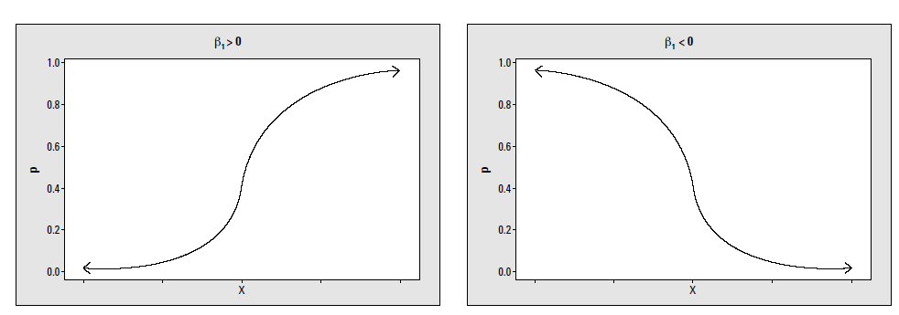
Interpretation
Based on the coefficient sign: The equation shows the relation between the probabilities of class i and the logistic regression coefficient. If the coefficient is positive then increasing X will be associated with increasing p(X). If the coefficient is negative then increasing X will be associated with decreasing p(X).

Slide 11




Odd ratio
The coefficient (b₁) is the amount the logit (log-odds) changes with a one unit change in x.
Odd: The odd of success is defined as ratio of probability of success to probability of failure. If p is equal to 0.8, then the above equation becomes
The odd is 4 which means that odd of success is 4 to 1. We knew that logistic regression gives log odd. If the β1 value is 1.6, it means that 1 unit change in X1 while others independent variables are at same level, produces 1.6 unit change in log of the odd. If we take exponential for log odd , we will get odd value.

Slide 12


Log($\frac{p}{1−p}$)= -10.65 + 0.005499*balance

Slide 13

The intercept= -9.79394 the log odds of a student with a math score of zero being in an honors class.
The coefficient for math= 0.15634 the expected change in log odds for a one-unit increase in the math score. The odds ratio can be calculated by exponentiation this value to get 1.16922
we expect to see about 17% increase in the odds of being in an honors class, for a one-unit increase in math score

Slide 14

Accuracy
Accuracy is one metric for evaluating classification models. Informally, accuracy is the fraction of predictions our model got right. Formally, accuracy has the following definition:

Slide 15
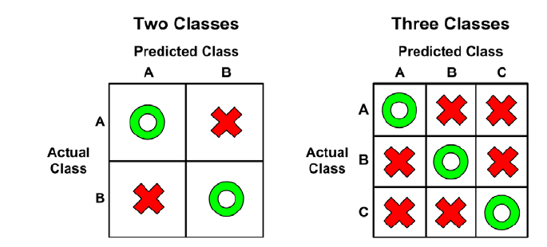
Performance Measurement
A confusion matrix is a table that categorizes predictions according to whether they match the actual value in the data.
When the predicted value is the same as the actual value, this is a correct classification. Correct predictions fall on the diagonal in the confusion matrix (denoted by O).
The off-diagonal matrix cells (denoted by X) indicate the cases where the predicted value differs from the actual value. These are incorrect predictions.

Slide 16
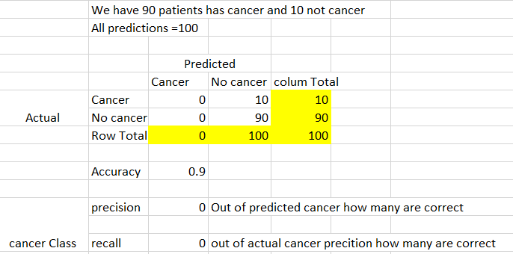
But when category is imbalance, need more importance like cancer detection, failure

Slide 17
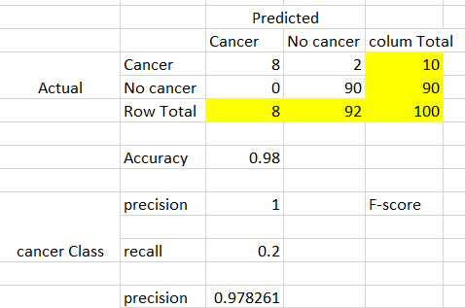

Slide 18


Precision/ Recall
Precision: What proportion of positive identifications is actually correct?
Recall: What proportion of actual positives was identified correctly?
Prediction
TP :1 | FN: 8
FP: 1 | TN :90
Actual

Slide 19
Precision and Recall: A Tug of War
To fully evaluate the effectiveness of a model, we must examine both precision and recall.
Unfortunately, precision and recall are often in tension. That is, improving precision typically reduces recall and vice versa.
Below example shows 30 predictions made by an email classification model.
Those to the right of the classification threshold are classified as "spam", while those to the left are classified as "not spam."

Slide 20
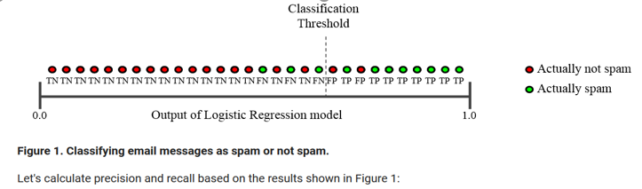
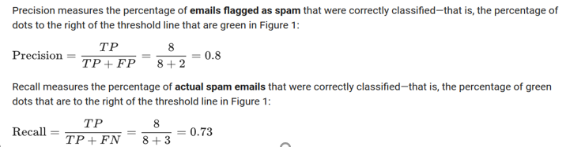
Prediction
8 | 3
2 | 17
Actual

Slide 21
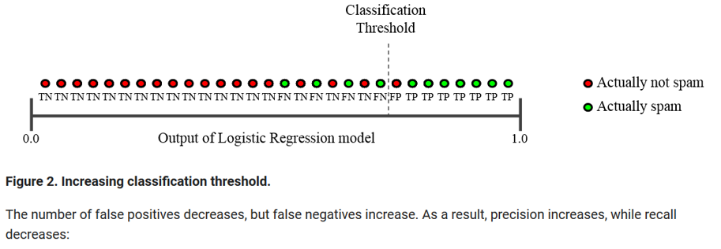
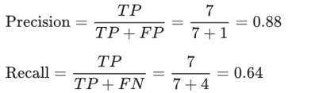
Prediction
TP :7 | FN: 4
FP: 1 | TN :18
Actual

Slide 22
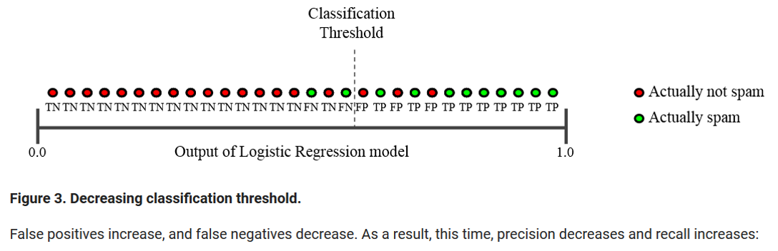
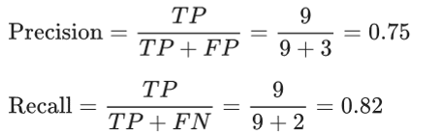
Prediction
TP :9 | FN: 2
FP: 3 | TN :16
Actual
Notes:
https://developers.google.com/machine-learning/crash-course/classification/precision-and-recall

Slide 23
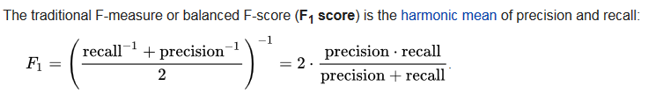
F1 Score

Slide 24
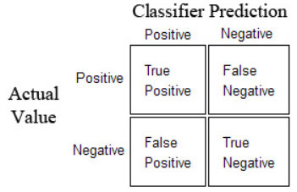
True Positive (TP): Correctly classified as the class of interest
True Negative (TN): Correctly classified as not the class of interest
False Positive (FP): Incorrectly classified as the class of interest
False Negative (FN): Incorrectly classified as not the class of interest

Slide 25
The sensitivity of a model (also called the true positive rate), measures the proportion of positive examples that were correctly classified. (precision)
The specificity of a model (also called the true negative rate), measures the proportion of negative examples that were correctly classified.

Slide 26


ROC curve
An ROC curve (receiver operating characteristic curve) is a graph showing the performance of a classification model at all classification thresholds. This curve plots two parameters:
True Positive Rate (TPR) is a synonym for recall and is therefore defined as follows:
False Positive Rate (FPR) is defined as follows:

Slide 27
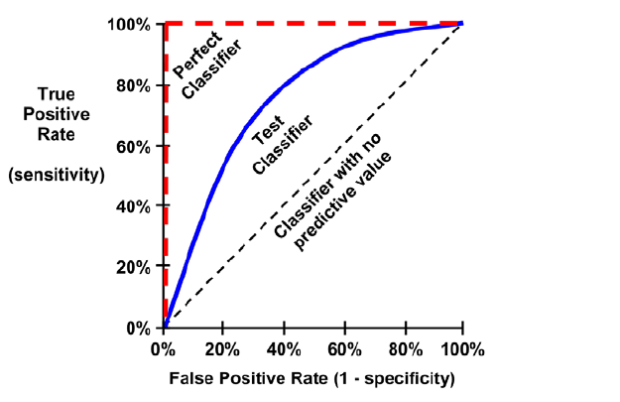

Slide 28
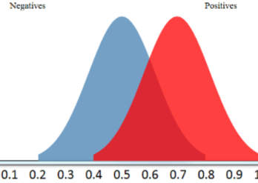
Convert Probability to Prediction
We decide on the threshold probability,
default value = 0.5
If Probability >0.5 the positive class
If less than then negative class

Slide 29
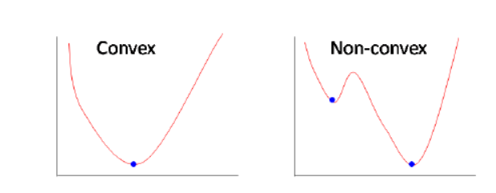
Why cost function which has been used for linear can not be used for logistic?
Linear regression uses mean squared error as its cost function. If this is used for logistic regression, then it will be a non-convex function of parameters (theta). Gradient descent will converge into global minimum only if the function is convex.

Slide 30
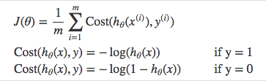
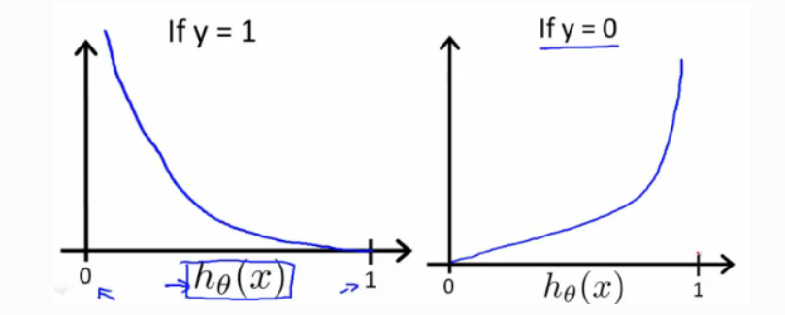

Cost Function
Instead of Mean Squared Error, we use a cost function called Cross-Entropy, also known as Log Loss. Cross-entropy loss can be divided into two separate cost functions: one for y=1 and one for y=0.
Notes:
https://towardsdatascience.com/logistic-regression-detailed-overview-46c4da4303bc

Slide 31


Maximum likelihood
This likelihood gives the probability of the observed zeros and ones in the data. We pick 0 and 1 to maximize the likelihood of the observed data.

Slide 32
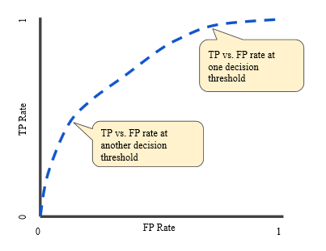
ROC curve
An ROC curve plots TPR vs. FPR at different classification thresholds. Lowering the classification threshold classifies more items as positive, thus increasing both False Positives and True Positives. The following figure shows a typical ROC curve.
To compute the points in an ROC curve, we could evaluate a logistic regression model many times with different classification thresholds, but this would be inefficient. Fortunately, there's an efficient, sorting-based algorithm that can provide this information for us, called AUC.

Slide 33
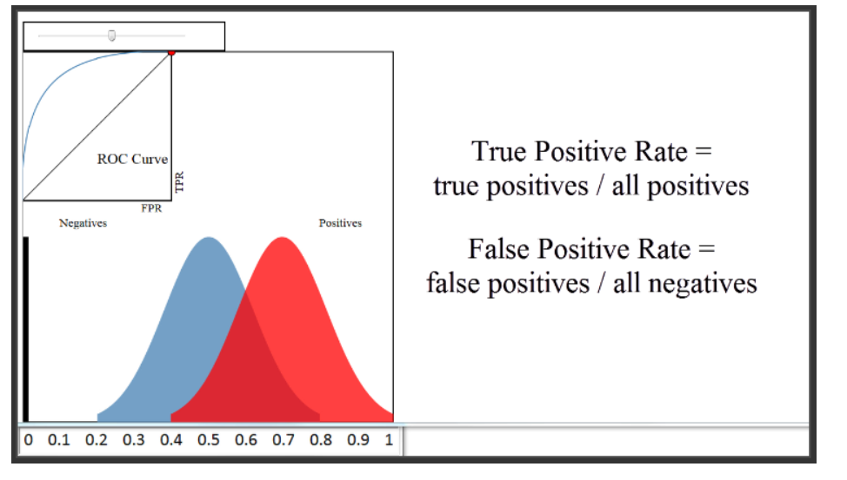
https://www.dataschool.io/roc-curves-and-auc-explained/ https://www.youtube.com/watch?v=OAl6eAyP-yo

Slide 34
An ROC curve is a commonly used way to visualize the performance of a binary classifier, meaning a classifier with two possible output classes.
For example, let's pretend you built a classifier to predict whether a research paper will be admitted to a journal, based on a variety of factors. The features might be the length of the paper, the number of authors, the number of papers those authors have previously submitted to the journal, et cetera. The response (or "output variable") would be whether or not the paper was admitted.

Slide 35
Reading Links
http://www.sthda.com/english/articles/36-classification-methods-essentials/151-logistic-regression-essentials-in-r/
https://www.machinelearningplus.com/machine-learning/evaluation-metrics-classification-models-r/
https://www.machinelearningplus.com/machine-learning/logistic-regression-tutorial-examples-r/
http://ethen8181.github.io/machine-learning/unbalanced/unbalanced.html

Slide 36
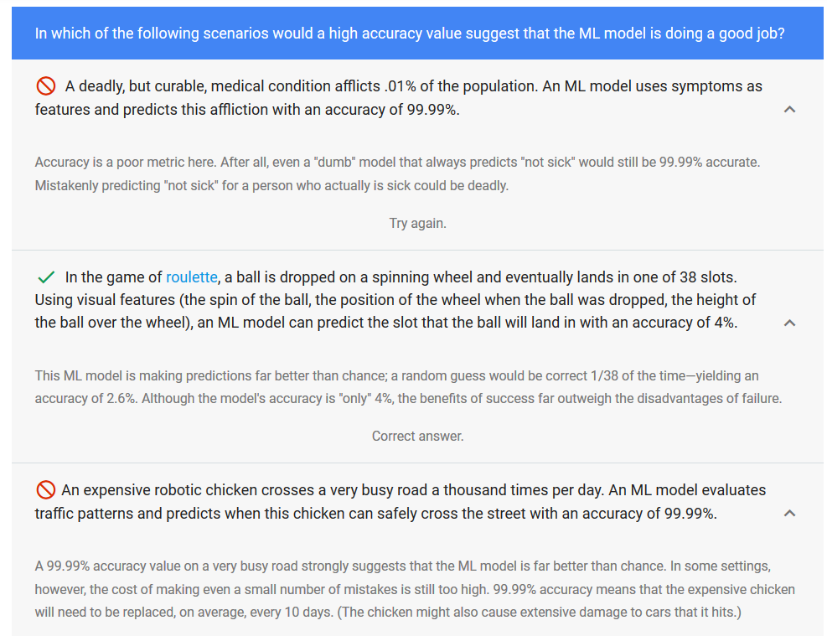

Slide 37
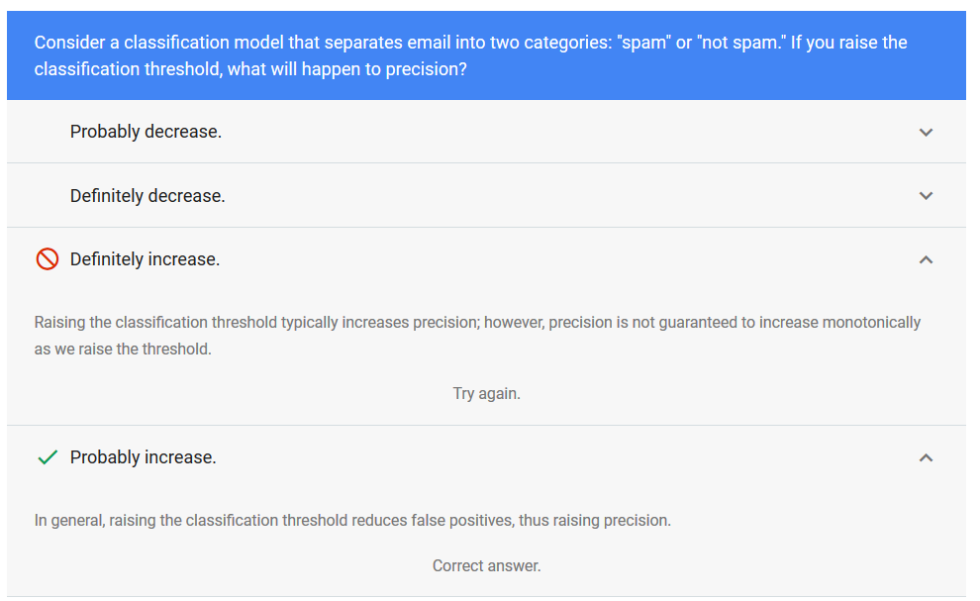

Slide 38
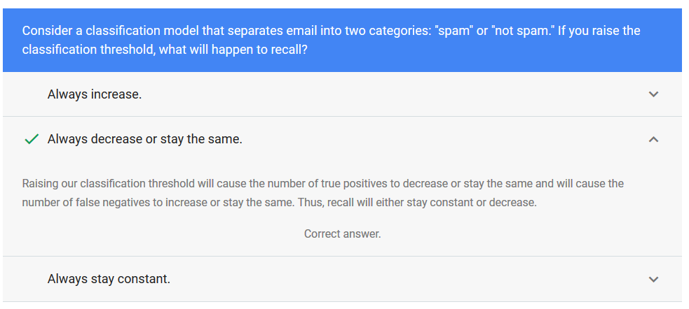

Slide 39
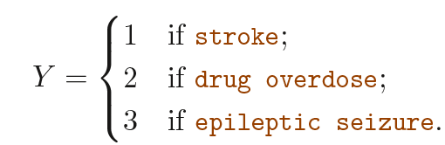
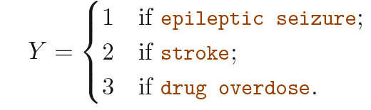
Why Not Linear Regression?
Suppose that we are trying to predict the medical condition of a patient in the emergency room on the basis of her symptoms.
Keeping drug overdose in between stroke and epileptic seizure, that the difference between stroke and drug overdose is the same as the difference between drug overdose and epileptic seizure. In practice there is no particular reason that this needs to be the case.
Second would imply a totally different relationship among the three conditions. Each of these codings would produce fundamentally different linear models that would ultimately lead to different sets of predictions on test observations.

Slide 40
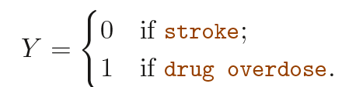
If the response variable’s values take on a natural ordering, such as mild, moderate, and severe, and the gap between mild and moderate is similar to the gap between moderate and severe, then a 1, 2, 3 coding would be reasonable.
A qualitative response variable with more than two levels without order is not appropriate for linear regression.
For a binary (two level) qualitative response, the situation is better. For Binary instance, if there are only two possibilities
Fit a linear regression to this binary response, and predict drug overdose if ˆY >0.5 and stroke otherwise. In the binary case it is not hard to show that even if we flip the above coding, linear regression will produce the same final predictions.(linear discriminant analysis (LDA))

Slide 41
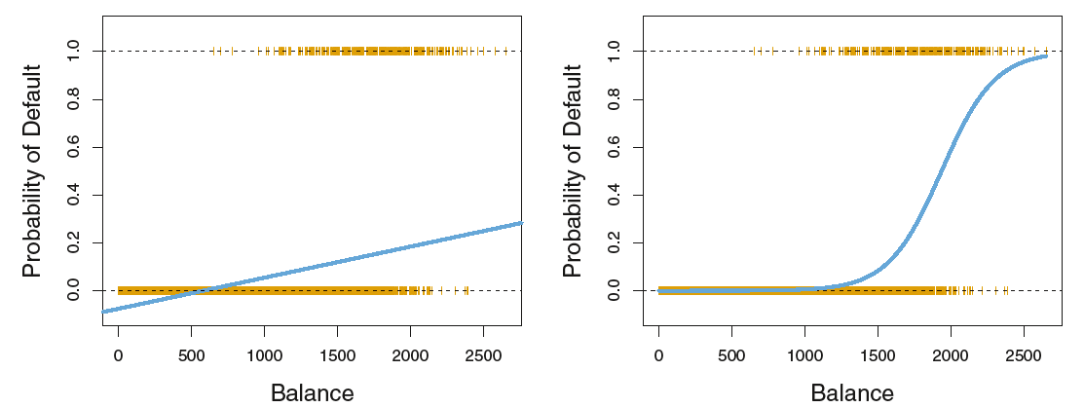
Classification using the Default data. Left: Estimated probability of default using linear regression. Some estimated probabilities are negative! The orange ticks indicate the 0/1 values coded for default(No or Yes).
Right: Predicted probabilities of default using logistic regression. All probabilities lie between 0 and 1.

Slide 42
Predicting whether an individual will default on credit card payment, on the basis of annual income and monthly credit card balance.
Default : A factor with levels No and Yes indicating whether the customer defaulted on their debt
Student: A factor with levels No and Yes indicating whether the customer is a student
Balance :The average balance that the customer has remaining on their credit card after making their monthly payment
Income : Income of customer

Slide 43
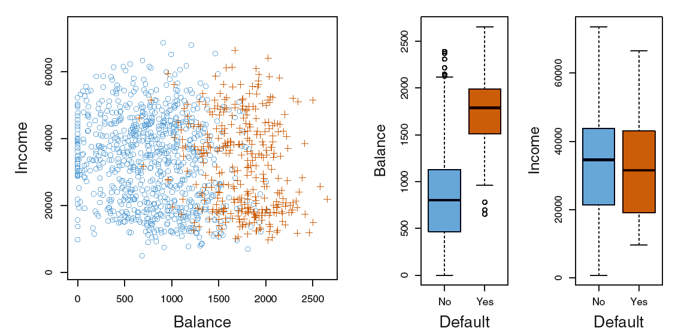

Slide 44

Rather than modeling this response Y directly, logistic regression models the probability that Y belongs to a particular category.
For the Default data, logistic regression models the probability of default. For example, the probability of default given balance can be written as
For example, one might predict default = Yes for any individual for whom p(default) > 0.5.
Alternatively, if a company wishes to be conservative in predicting individuals who are at risk for default, then they may choose to use a lower threshold, such as p(default) > 0.1.

Slide 45
Maximum Likelihood Estimation (MLE) is a fundamental concept in machine learning and statistics that plays a crucial role in parameter estimation for probabilistic models.
The goal of MLE is to find the set of parameter values that maximize the likelihood function, which measures the probability of observing the given data under the assumed model.
For independent and identically distributed (i.i.d.) data, the likelihood is often expressed as the product of the individual data point probabilities.
Log-Likelihood Function: In practice, it is common to work with the log-likelihood function, denoted by log L(θ | D), which is the natural logarithm of the likelihood function.
MLE Objective: The MLE objective is to find the parameter values θ that maximize the log-likelihood function

